Slide 1


Food adulteration acts
Mary Anupama Palukurty
Assistant Professor,
Dept. of Biochemistry,
St.Joseph’s College for Women (A),
Visakhapatnam

Slide 2

Role of Central Government / PFA Cell
The Prevention of Food and Adulteration Act is a Central legislation.
The Rules and Standards framed under the Act are uniformly applicable throughout the country.
Besides, framing of rules and standards, the following activities are also undertaken by the Ministry of Health and Family Welfare

Slide 3


- To keep close liaison with states/local bodies for uniform implementation of food laws.
- To monitor the activities of states by collecting periodical reports on working of food laws, getting the reports of food poisoning cases and visiting the states from time to time.
- To arrange periodical training programme for Senior Officers/Inspectors/Analysts.

Slide 4

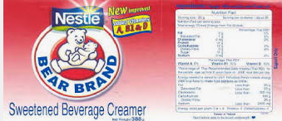

- To create consumers awareness about the programme by holding workshop/Exhibitions/seminars/training programmes and publishing pamphlets.
- To approve labels of proprietary food in the category of infant milk substitute and Infant food, so as to safeguard the health of infants.
- To coordinate with international bodies like ISO/FAO/WHO and Codex Alimentarius commission

Slide 5
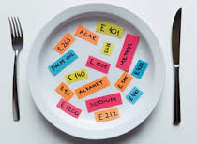

- To carry out survey-cum-monitoring activities on food additives, (physical, chemical and microbiological) contaminants etc. .
-To give administrative/financial/ technical support to four Central Food Laboratories situated in Kolkata, Ghaziabad, Mysore and Pune and providing technical guidance to the food laboratories set up by states/local Bodies.

Slide 6


- To hold activities connected with National Monitoring Agency vested with powers to decide policy issues on food fortification, preservations, irradiation etc.
- To formulate manual of sampling and method of analysis of food.
- To formulate training materials for Food Safety Systems ( GHP, GMP, HACCP) etc

Slide 7
PFA act
PFA Act envisages the elimination/ prevention of adulteration of food, which is a menace to public health, and thus eradicates the social evil and ensures providing pure and wholesome food to the public.
The Preamble of the Act viz.
The term “Prevention of Adulteration of the Food” denotes the policy and object behind the Act. It discloses the primary intention of the legislature, and the provisions of the Act are the key to the mind of the legislature.
There are 25 sections in the Act.
The Act passed by the Parliament was assented by the President on 29th September, 1954 and published as Act no. 37 of 1954 on 30th September, 1954 and came into force from 1st June, 1955 vide S.No. 1085 dated 9th May, 1955.

Slide 8
Kinds of Adulteration included in the Act
1. Substandard quality
2. Substitution by cheaper substance
3. Abstraction of any constituent of article
4. Preparation or storage in unsanitary conditions
5. Poisonous ingredients
6. Colouring agents and / or preservatives in excess of prescribed limits.
7. Quality or purity below the prescribed standards
8. If the constituents of the article are present in quantities which are not within prescribed limit.

Slide 9
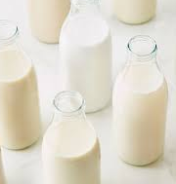
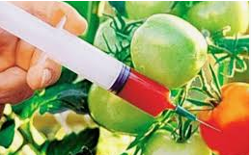
Adulterated Food
(i) Milk not confirming to standard is adulterated (standard required fat and solid content 14%) but the milk contained fat 5.7% and solid 7.25% i.e. total 13%.
(ii) Excess content of fat than the prescribed level will also amount to adulteration.
(iii) The knowledge and awareness of the buyer is wholly immaterial as the object of the act is to protect the public.

Slide 10
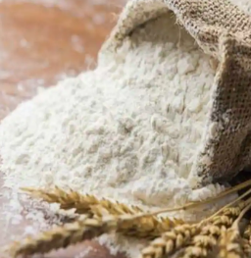
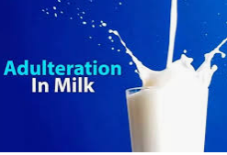
(iv) Sale of wheat flour as pure when it contains some mixture of barely (the quantum of admixture is immaterial)
(v) The addition of water with milk is adulteration
(vi) Sale of mixed linseed and rapeseed oil amounts to sale of adulterated oil.

Slide 11
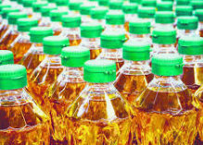

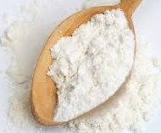
(vi) Sale of mixed linseed and rapeseed oil amounts to sale of adulterated oil.
(vii) Insect infested: Living – (not for human consumption) Dead
(viii) Suji and maida samples containing large number of alive and dead insects or adulterated.

Slide 12
(ix) Pan masala is food – Tobacco comes under the definition of food.
(x) Country liquor – comes under the definition of food.
(i) Food made available in a hotel is food
(ii) Wheat flour kept in Dhaba for preparation of Chapatis for sale is food

Slide 13
Articles held as Food by Courts
1. Arhar Dal
2. Coconut oil
3. Country liquor
4. Fruits
5. Cota Haldi
6. Gram Flour
7. Groundnut oil
8. Gunja Oil
9. Gur
10. Ice Fruit
11. Jaggery
12. Kesari Dal
13. Mustard Oil
14. Tea Flour
15. Tea
16. Til Oil
17. Wines Liquors

Slide 14
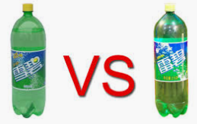
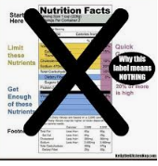
What is Misbranded Food
An article is considered as misbranded :
1. If an article is an imitation of, or is substitute for another article of food;
2. If it is sold under the name of another article;
3. If the true character of the article is not indicated plainly and conspicuously on the label;
4. If it is sold by a name which belongs to another article of good

Slide 15

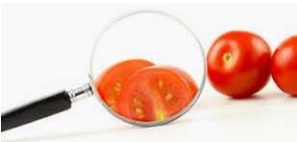
5. Makes false claim for the article on the label or otherwise;
6. If the fact of an article beings damaged is concealed through colouring, polishing etc.
7. If the contents of each package are not conspicuously and correctly stated on the outside of the package.

Slide 16
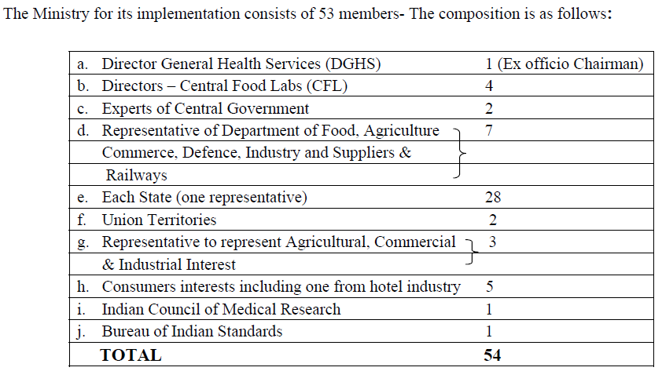
FUNCTIONS / RESPONSIBILITIES OF VARIOUS AUTHORITIES

Slide 17
Thank you

